Slide 1
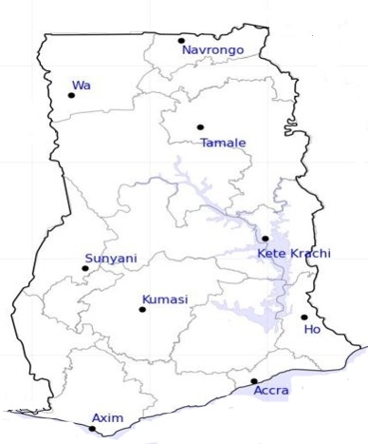




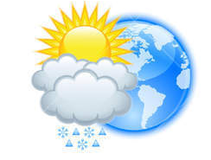






WEATHER FORECAST
24-HOUR FORECAST
18-11-2022 @ 1200 UTC
Rain
Wind
Dust
.
Forecast Summary (KUMASI)
 | DAY | NIGHT
Temperature | 31 | 24
Rain | No | Light
Probability | - | 10%
Rel. Humidity | 71 % | 89 %
Winds from | S | S
Wind Speed | 2 ms⁻¹ | 2 ms⁻¹
Wind Gust | 5 ms⁻¹ | 5 ms⁻¹
Low risk
Be aware
Be Prepared
Take Action
LORD BRIGHT BOATENG
SUNSET: 05:46 PM SUNRISE: 5:59 AM
POWERED BY:

